Slide 1
OSPF
Routing Protocols and Concepts – Chapter 11

Slide 2
Objectives
Describe the background and basic features of OSPF
Identify and apply the basic OSPF configuration commands
Describe, modify and calculate the metric used by OSPF
Describe the Designated Router/Backup Designated Router (DR/BDR) election process in multiaccess networks
Describe the uses of additional configuration commands in OSPF

Slide 3
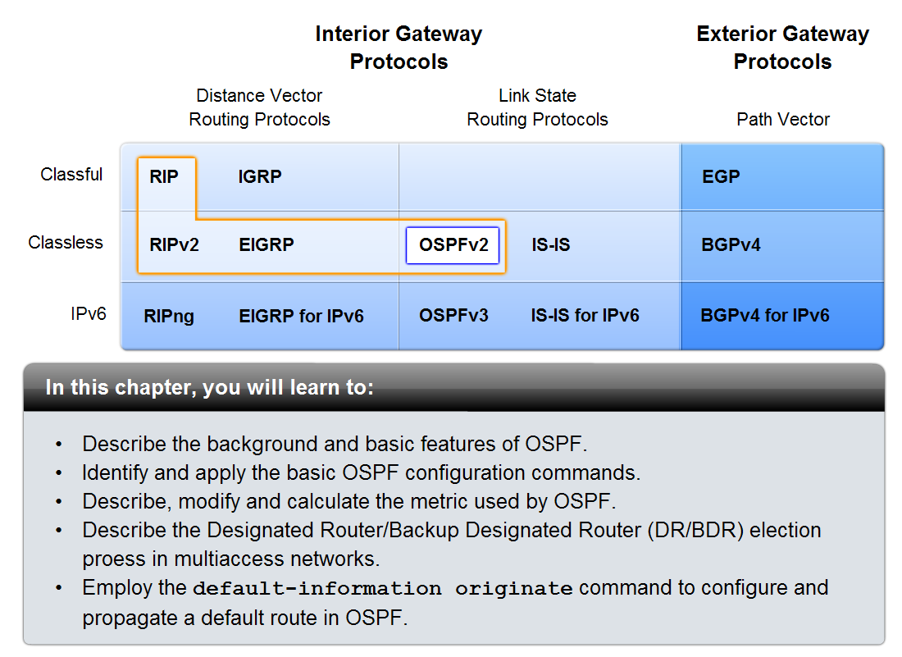
Introduction

Slide 4
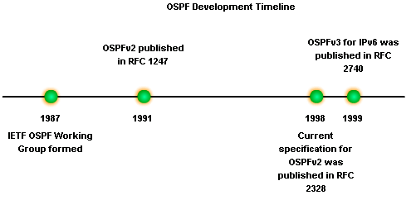
Introduction to OSPF
Background of OSPF
Began in 1987
1989 OSPFv1 released in RFC 1131
This version was experimental & never deployed
1991 OSPFv2 released in RFC 1247
1998 OSPFv2 updated in RFC 2328
1999 OSPFv3 published in RFC 2740

Slide 5
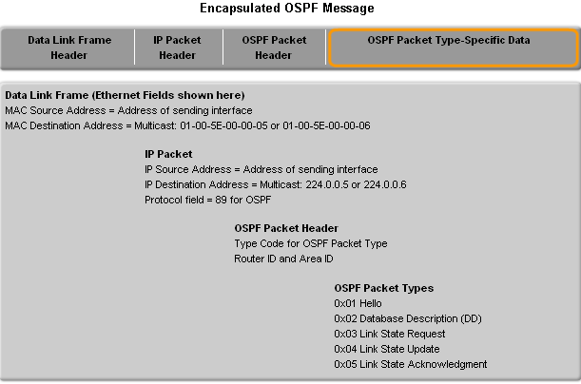
OSPF Message

Slide 6
Introduction to OSPF
OSPF Message Encapsulation
OSPF packet type
  There exist 5 types
OSPF packet header
  Contains - Router ID and area ID and Type code for OSPF packet type
IP packet header
Contains - Source IP address, Destination IP address, & Protocol field set to 89

Slide 7
Introduction to OSPF
OSPF Message Encapsulation
Data link frame header
Contains - Source MAC address and Destination MAC address

Slide 8
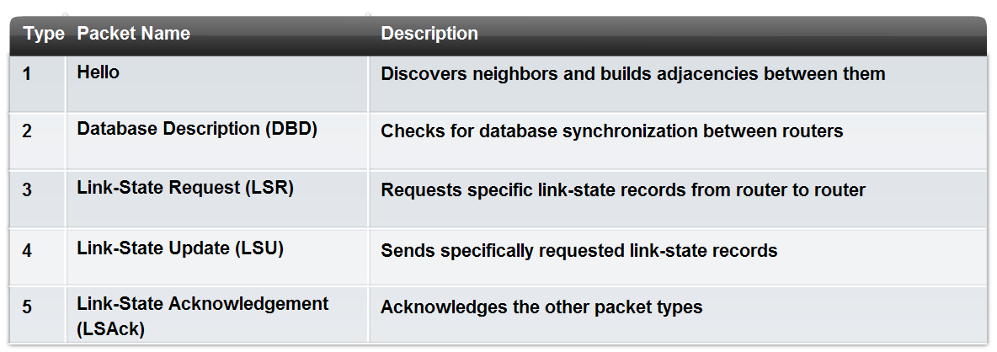
Introduction to OSPF
OSPF Packet Types

Slide 9
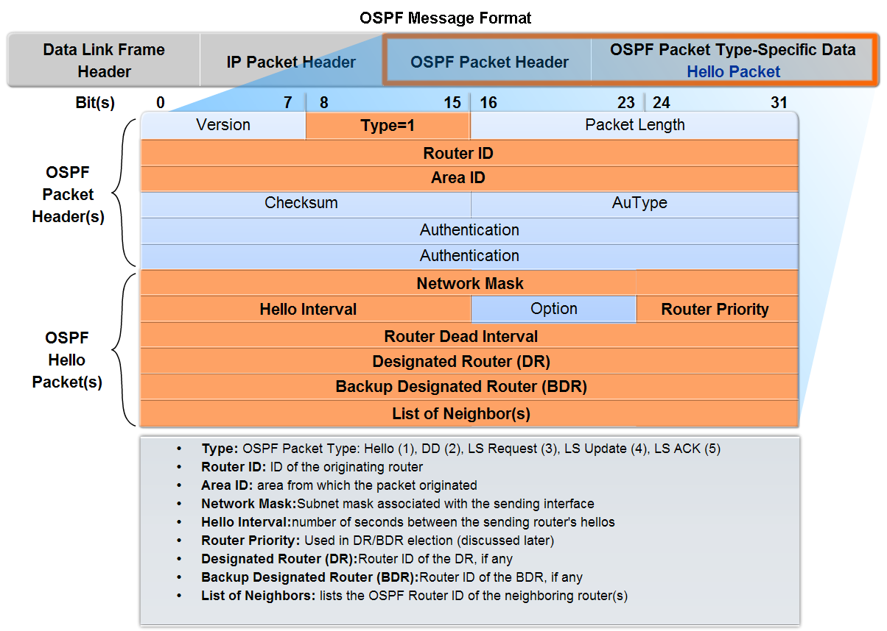
Introduction to OSPF
Hello Protocol
OSPF Hello Packet
  Purpose of Hello Packet
    Discover OSPF neighbors & establish adjacencies
    Advertise guidelines on which routers must agree to become neighbors
    Used by multi-access networks to elect a designated router and a backup designated router

Slide 10
Packet Header

Slide 11
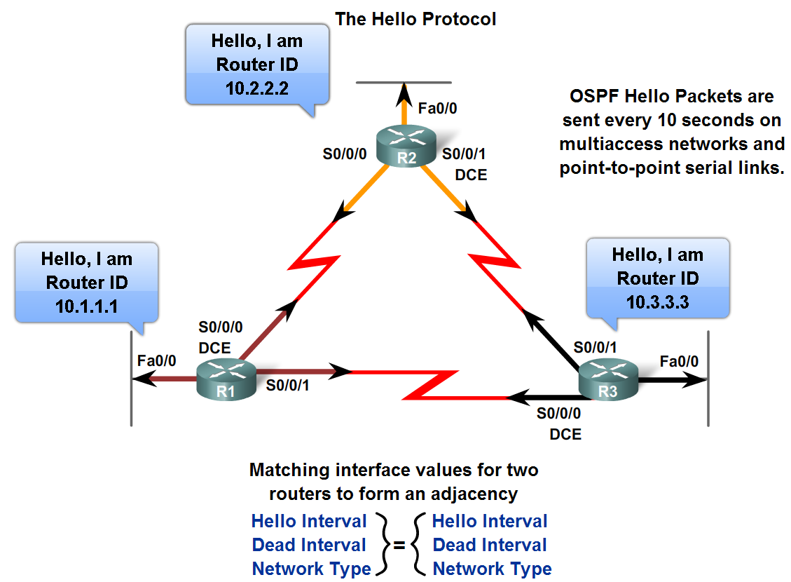
Introduction to OSPF
Hello Packets continued
  Contents of a Hello Packet
  router ID of transmitting router
OSPF Hello Intervals
  Usually multicast (224.0.0.5)
  Sent every 30 seconds for NBMA segments
OSPF Dead Intervals
  This is the time that must transpire
  before the neighbor is considered
  down
  Default time is 4 times
  the hello interval

Slide 12
Hello Intervals
Before two routers can form an OSPF neighbor adjacency, they must agree on three values: Hello interval, Dead interval, and network type.
The OSPF Hello interval indicates how often an OSPF router transmits its Hello packets.
By default, OSPF Hello packets are sent every 10 seconds on multiaccess and point-to-point segments and every 30 seconds on non-broadcast multiaccess (NBMA) segments (Frame Relay, X.25, ATM).
In most cases, OSPF Hello packets are sent as multicast to an address reserved for ALLSPFRouters at 224.0.0.5.
Using a multicast address allows a device to ignore the packet if its interface is not enabled to accept OSPF packets. This saves CPU processing time on non-OSPF devices.

Slide 13
Dead Intervals
The Dead interval is the period, expressed in seconds, that the router will wait to receive a Hello packet before declaring the neighbor "down."
Cisco uses a default of four times the Hello interval. For multiaccess and point-to-point segments, this period is 40 seconds. For NBMA networks, the Dead interval is 120 seconds.
If the Dead interval expires before the routers receive a Hello packet, OSPF will remove that neighbor from its link-state database.
The router floods the link-state information about the "down" neighbor out all OSPF enabled interfaces.

Slide 14
Introduction to OSPF
Hello protocol packets contain information that is used in electing
  -Designated Router (DR)
  DR is responsible for updating all other OSPF routers
  -Backup Designated Router (BDR)
  This router takes over DR’s responsibilities if DR fails

Slide 15
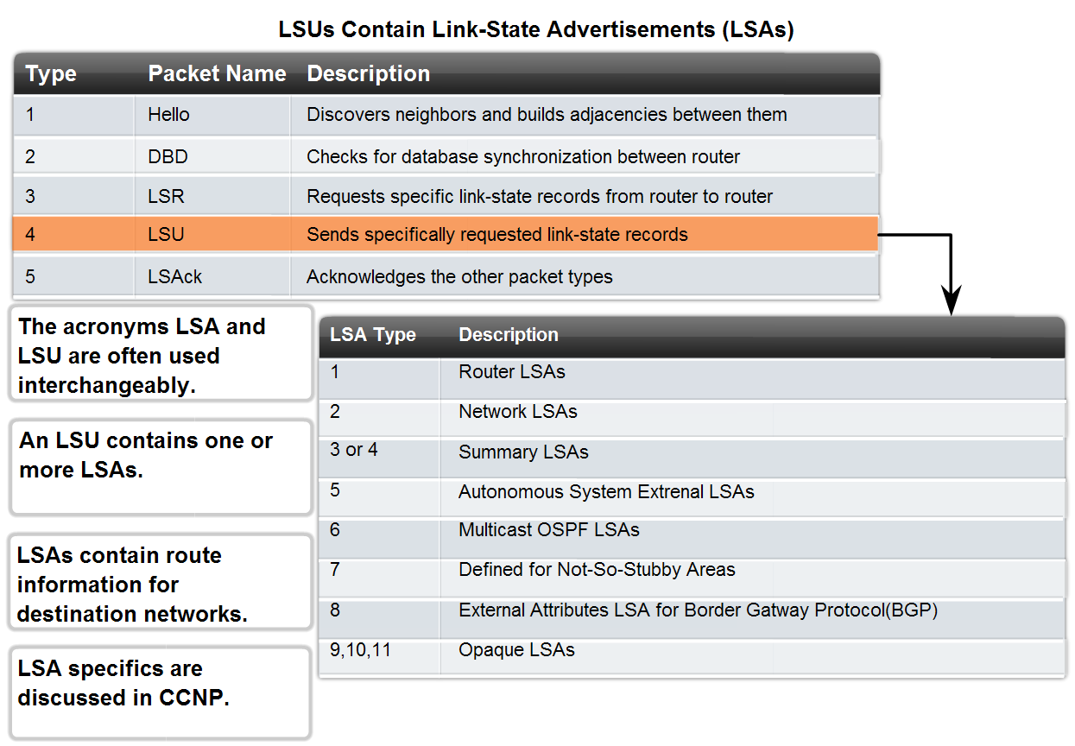
Introduction to OSPF
OSPF Link-state Updates
Purpose of a Link State Update (LSU)
  Used to deliver link state advertisements
Purpose of a Link State Advertisement (LSA)
  Contains information about neighbors & path costs

Slide 16
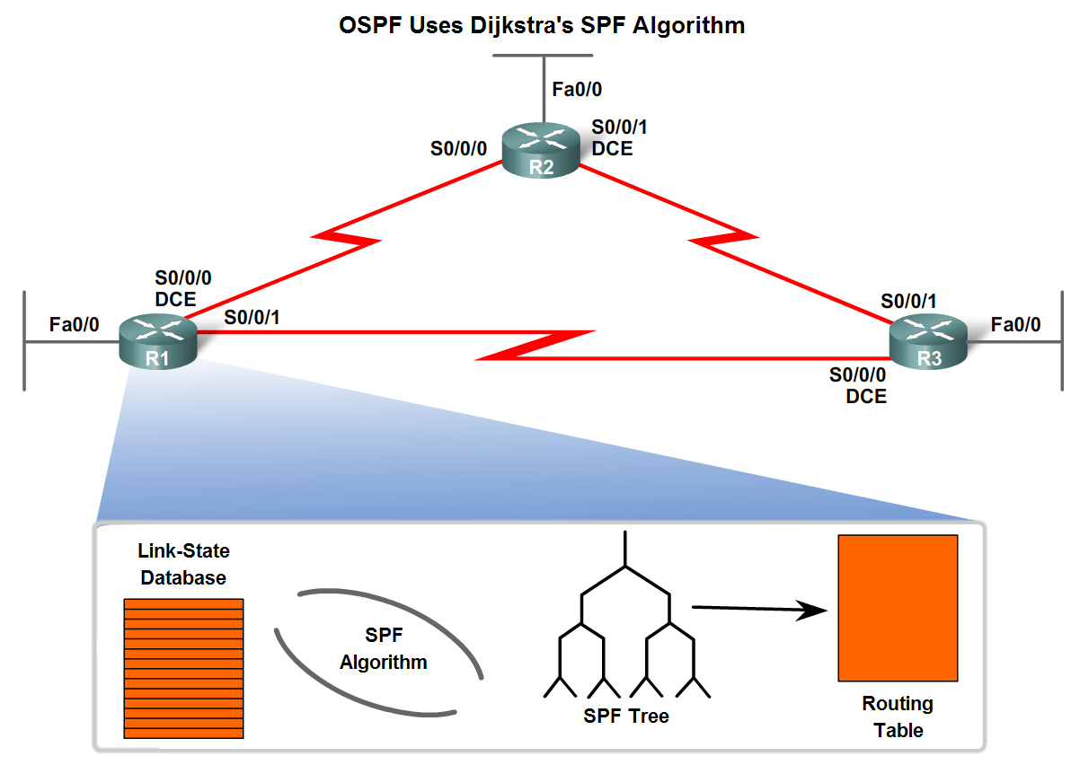
Introduction to OSPF
OSPF Algorithm
OSPF routers build & maintain link-state database containing LSA received from other routers
  Information found in database is utilized upon execution of Dijkstra SPF algorithm
  SPF algorithm used to create SPF tree
  SPF tree used to populate routing table

Slide 17
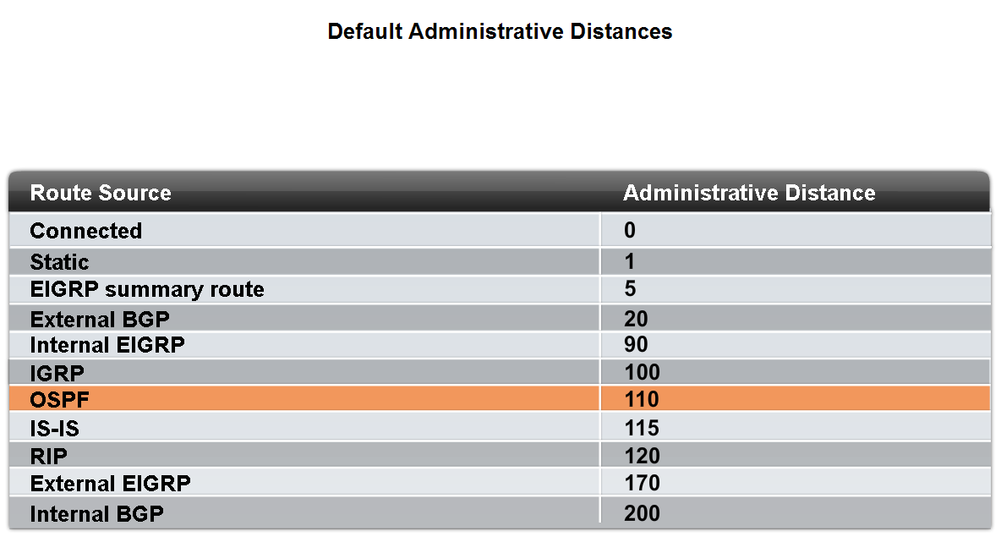
Introduction to OSPF
Administrative Distance
Default Administrative Distance for OSPF is 110

Slide 18
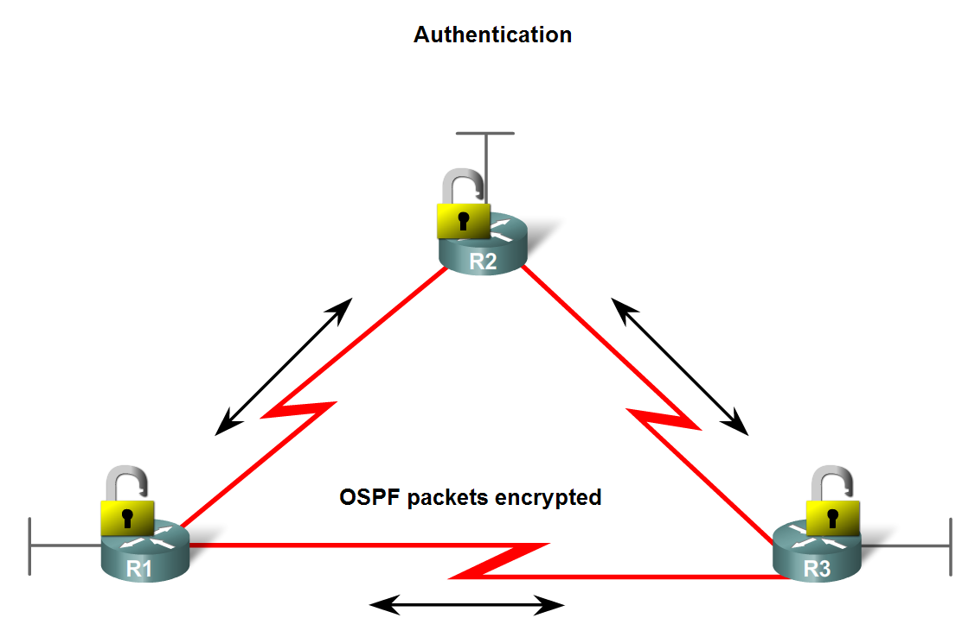
Introduction to OSPF
OSPF Authentication
  Purpose is to encrypt & authenticate routing information
  This is an interface specific configuration
  Routers will only accept routing information from other routers that have been configured with the same password or authentication information

Slide 19
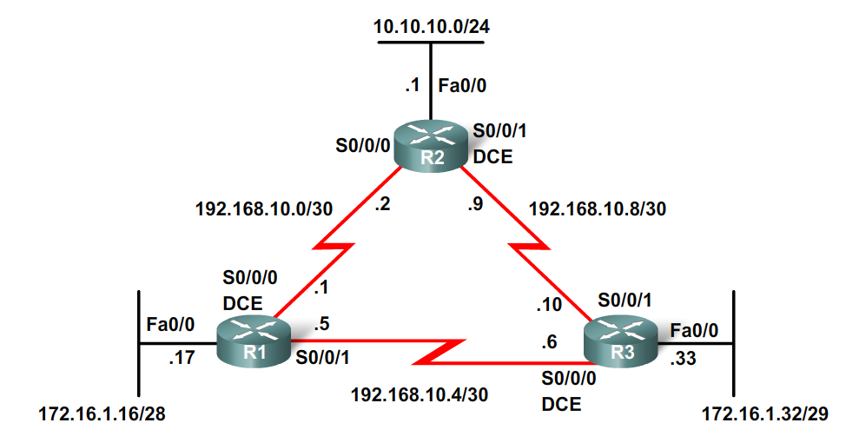
Basic OSPF Configuration
Lab Topology
Topology used for this chapter
  Discontiguous IP addressing scheme
  Since OSPF is a classless routing protocol the subnet mask is configured

Slide 20
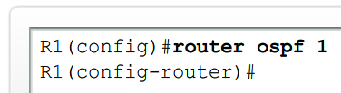


Basic OSPF Configuration
The router ospf command
To enable OSPF on a router use the following command
  R1(config)#router ospf process-id
  Process id
  A locally significant number between 1 and 65535
  -this means it does not have to match other OSPF routers

Slide 21
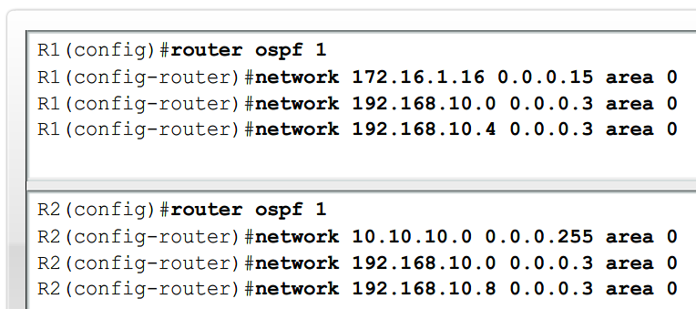
Basic OSPF Configuration
OSPF network command
  -Requires entering: network address
  wildcard mask - the inverse of the subnet mask
  area-id - area-id refers to the OSPF area. OSPF area is a group of routers that share link state information
  -Example: Router(config-router)#network network-address wildcard-ask area area-id

Slide 22
Basic OSPF Configuration
Router ID
  This is an IP address used to identify a router in an OSPF domain
  3 criteria for deriving the router ID
    Use IP address configured with OSPF router-id command
      -Takes precedence over loopback and physical interface addresses
    If router-id command not used then router chooses highest IP address of any loopback interfaces
    If no loopback interfaces are configured then the highest IP address on any active interface is used
    The process-id is locally significant, which means that it does not have to match other OSPF routers in order to establish adjacencies with those neighbors. This differs from EIGRP. The EIGRP process ID or autonomous system number does need to match for two EIGRP neighbors to become adjacent.

Slide 23
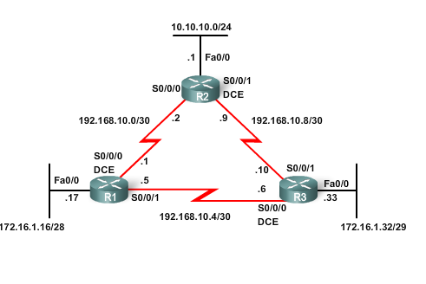
Sample Topology
Because we have not configured router IDs or loopback interfaces on our three routers, the router ID for each router is determined by the number three criterion in the list: the highest active IP address on any of the router's physical interfaces.

Slide 24
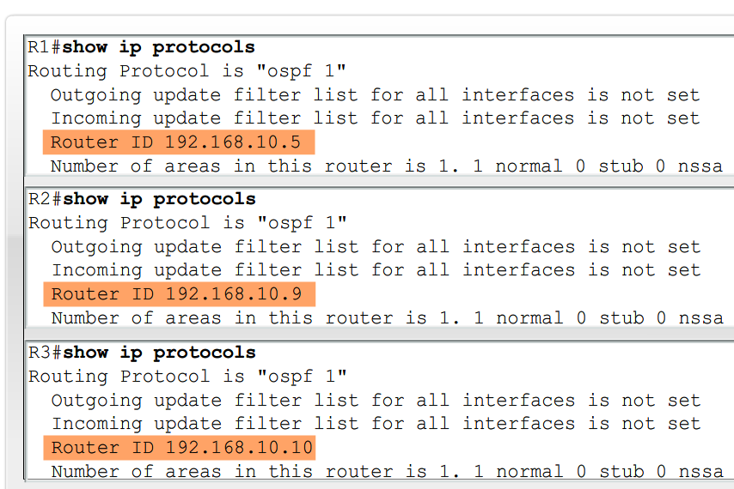
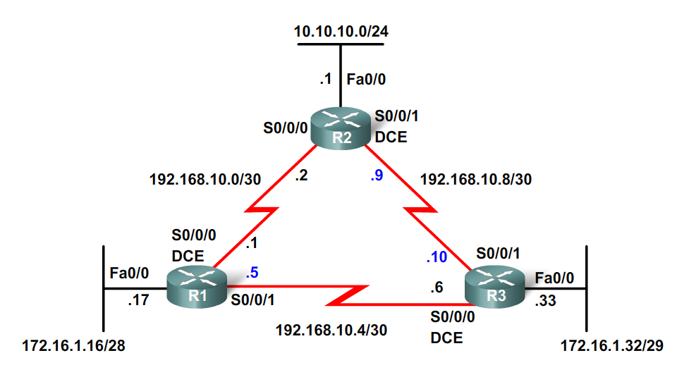
Basic OSPF Configuration
OSPF Router ID
Commands used to verify current router ID
  Show ip protocols
  Show ip ospf
  Show ip ospf interface

Slide 25

Basic OSPF Configuration
OSPF Router ID
Router ID & Loopback addresses
  -Highest loopback address will be used as router ID if router-id command isn’t used
  -Advantage of using loopback address
  the loopback interface cannot fail → OSPF stability
The OSPF router-id command
  Introduced in IOS 12.0
  Command syntax
    Router(config)#router ospf process-id
    Router(config-router)#router-id ip-address
Modifying the Router ID
  Use the command Router#clear ip ospf process

Slide 26
Modifying the Router ID
The router ID is selected when OSPF is configured with its first OSPF network command.
If the OSPF router-id command or the loopback address is configured after the OSPF network command, the router ID will be derived from the interface with the highest active IP address.
The router ID can be modified with the IP address from a subsequent OSPF router-id command by reloading the router or by using the following command:
Router#clear ip ospf process

Slide 27
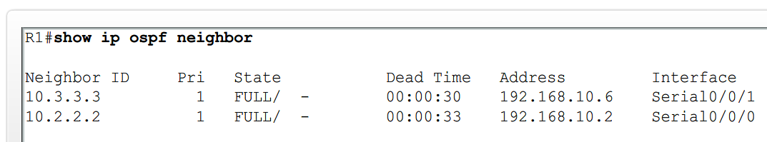
Basic OSPF Configuration
Verifying OSPF
Use the show ip ospf command to verify & trouble shoot OSPF networks
  Command will display the following:
  Neighbor adjacency
  -No adjacency indicated by -
        Neighboring router’s Router ID is not displayed
        A state of full is not displayed
  -Consequence of no adjacency-
        No link state information exchanged
        Inaccurate SPF trees & routing tables

Slide 28
OSPF Parameters
Neighbor ID - The router ID of the neighboring router.
Pri - The OSPF priority of the interface. This is discussed in a later section.
State - The OSPF state of the interface. FULL state means that the router and its neighbor have identical OSPF link-state databases. OSPF states are discussed in CCNP.
Dead Time - The amount of time remaining that the router will wait to receive an OSPF Hello packet from the neighbor before declaring the neighbor down. This value is reset when the interface receives a Hello packet.
Address - The IP address of the neighbor's interface to which this router is directly connected.
Interface - The interface on which this router has formed adjacency with the neighbor.

Slide 29
Basic OSPF Configuration
Verifying OSPF - Additional Commands
Command | Description
Show ip protocols | Displays OSPF process ID, router ID, networks router is advertising & administrative distance
Show ip ospf | Displays OSPF process ID, router ID, OSPF area information & the last time SPF algorithm calculated
Show ip ospf interface | Displays hello interval and dead interval

Slide 30
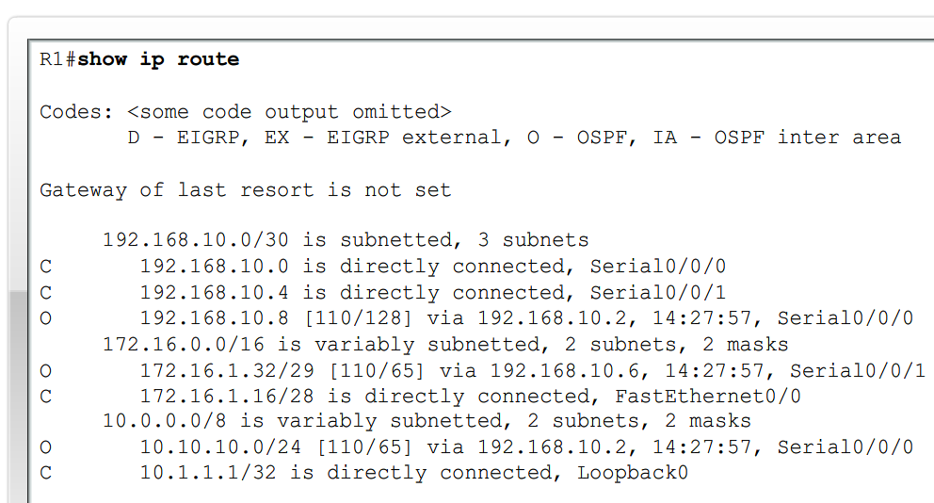
Basic OSPF Configuration
Examining the routing table
Use the show ip route command to display the routing table
  -An “O’ at the beginning of a route indicates that the router source is OSPF
  -Note OSPF does not automatically summarize at major network boundaries

Slide 31
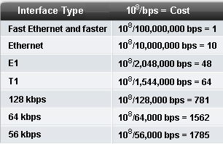
OSPF Metric
OSPF uses cost as the metric for determining the best route
  -The best route will have the lowest cost
  -Cost is based on bandwidth of an interface
    Cost is calculated using the formula
  10⁸ / bandwidth
  -Reference bandwidth
    defaults to 100Mbps
    can be modified using
    auto-cost reference-bandwidth command

Slide 32
Bandwidth and Costs

Slide 33
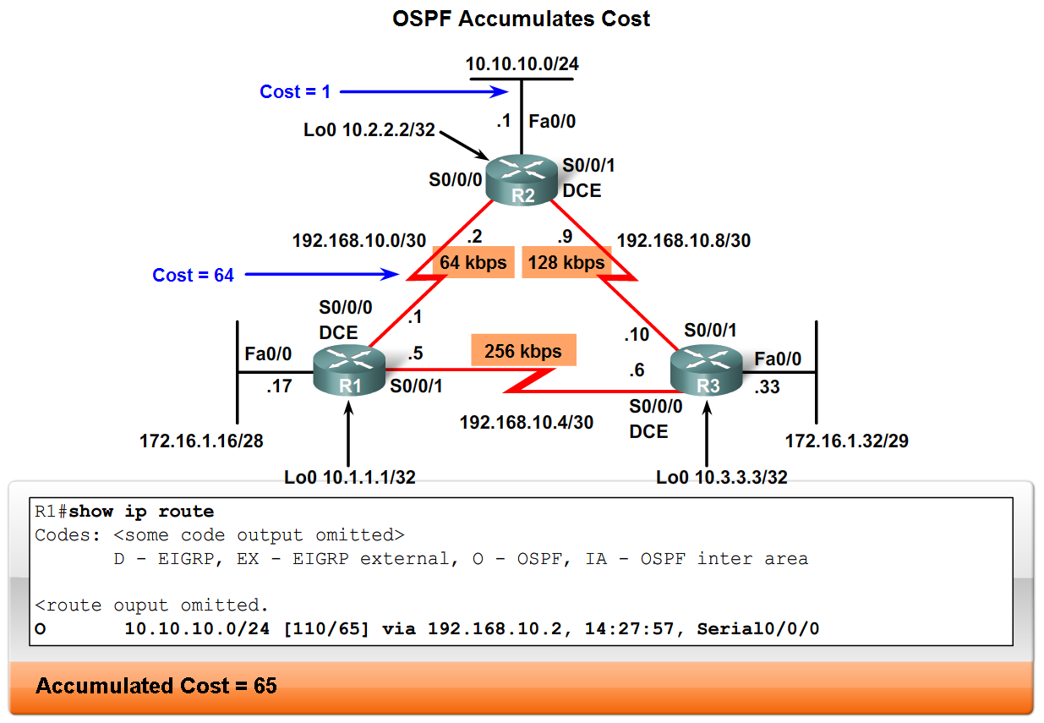
OSPF Metric
COST of an OSPF route
  Is the accumulated value from one router to the next

Slide 34
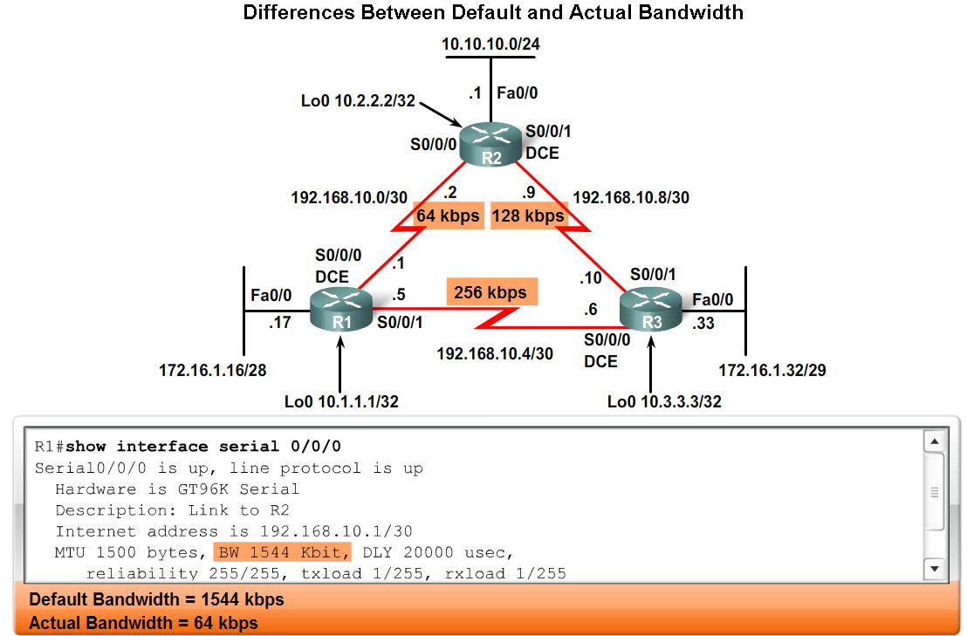
OSPF Metric
Usually the actual speed of a link is different than the default bandwidth
  This makes it imperative that the bandwidth value reflects link’s actual speed
    Reason: so routing table has best path information
The show interface command will display interface’s bandwidth
  -Most serial link default to 1.544Mbps

Slide 35
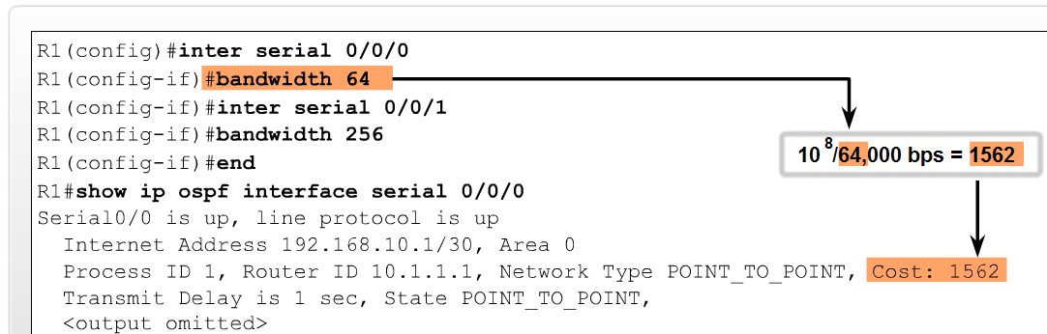
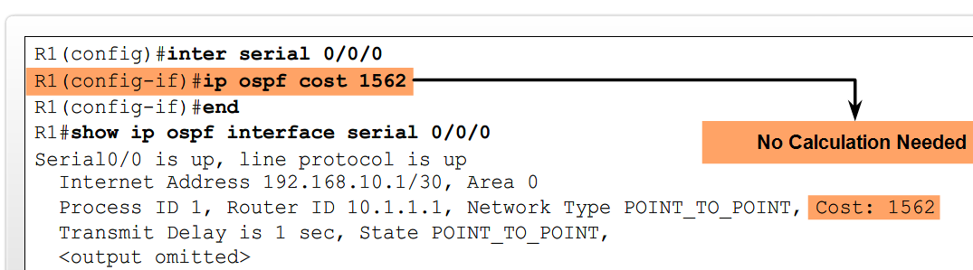
Basic OSPF Configuration
Modifying the Cost of a link
Both sides of a serial link should be configured with the same bandwidth
  Commands used to modify bandwidth value
    Bandwidth command
      Example: Router(config-if)#bandwidthbandwidth-kbps
    ip ospf cost command – allows you to directly specify interface cost
      -Example:R1(config)#interface serial 0/0/0
      R1(config-if)#ip ospf cost 1562

Slide 36
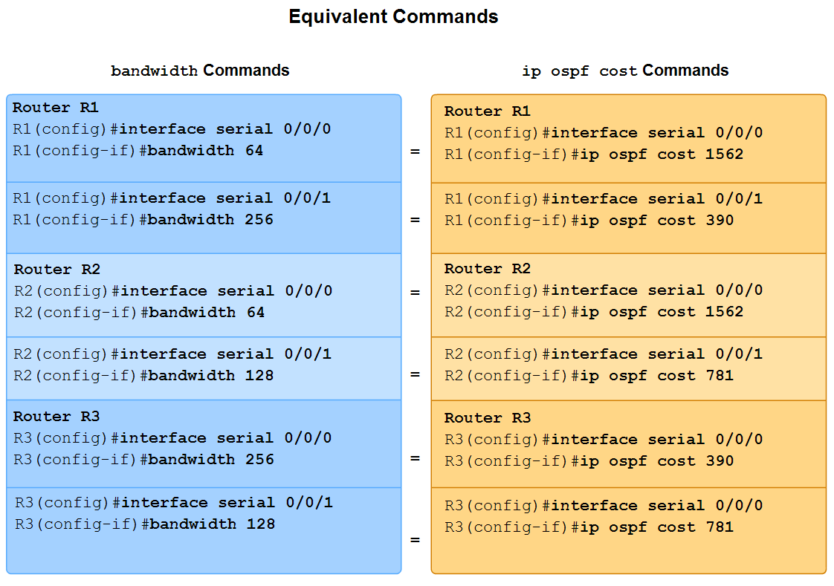
Basic OSPF Configuration
Modifying the Cost of the link
Difference between bandwidth command & the ip ospf cost command
  Ip ospf cost command
    Sets cost to a specific value
  Bandwidth command
    Link cost is calculated

Slide 37
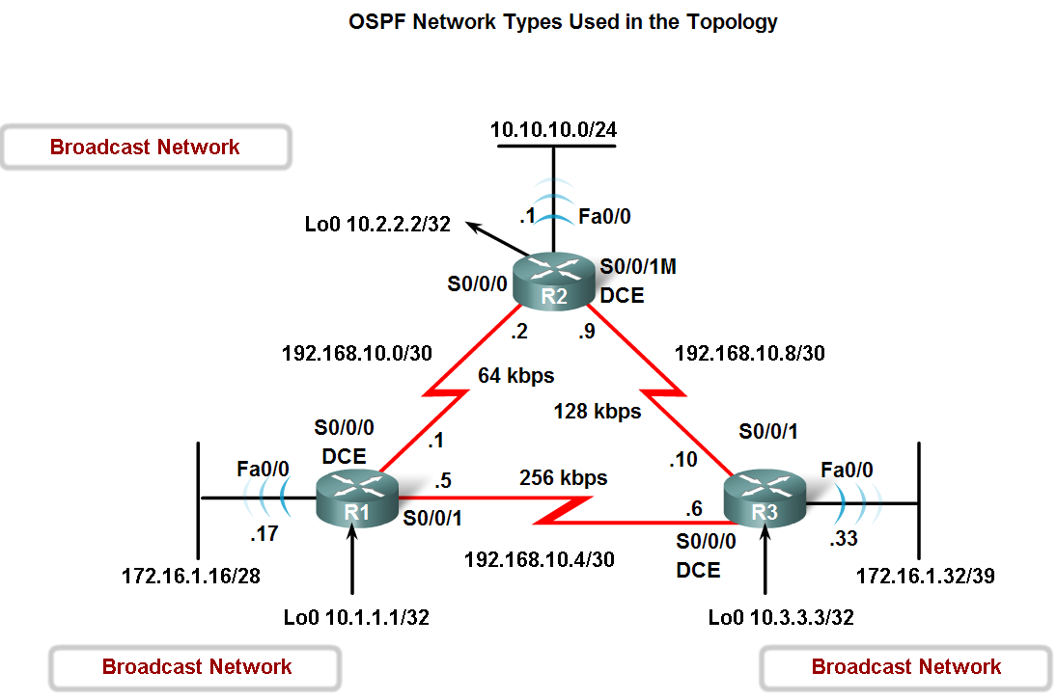
OSPF and Multiaccess Networks
Challenges in Multiaccess Networks
OSPF defines five network types:
  Point-to-point
  Broadcast Multiaccess
  Nonbroadcast Multiaccess (NBMA)
  Point-to-multipoint
  Virtual links

Slide 38
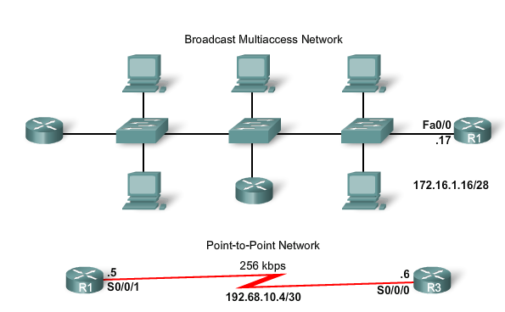
Network Types

Slide 39
Multi-access vs. P-to-P
A multi-access network is a network with more than two devices on the same shared media.
In the top portion of the figure, the Ethernet LAN attached to R1 is extended to show possible devices that might be attached to the 172.16.1.16/28 network. Ethernet LANs are an example of a broadcast multi-access network.
They are broadcast networks because all devices on the network see all broadcast frames.
They are multi-access networks because there may be numerous hosts, printers, routers, and other devices that are all members of the same network.
In contrast, on a point-to-point network there are only two devices on the network, one at each end.
The WAN link between R1 and R3 is an example of a point-to-point link. The bottom portion of the figure shows the point-to-point link between R1 and R3.

Slide 40
Note
NBMA and point-to-multi-point networks include Frame Relay, ATM, and X.25 networks.
NBMA networks are discussed in another CCNA course. Point-to-multipoint networks are discussed in CCNP.
Virtual links are a special type of link that can be used in multi-area OSPF. OSPF virtual links are discussed in CCNP.

Slide 41
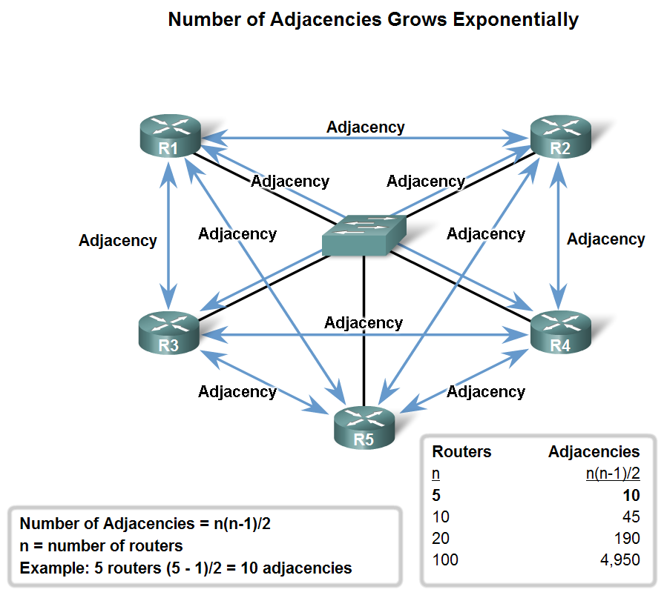
OSPF in Multiaccess Networks
2 challenges presented by multiaccess networks
  Multiple adjacencies
  Extensive LSA flooding

Slide 42
Multiple Adjacencies
The creation of an adjacency between every pair of routers in a network would create an unnecessary number of adjacencies.
This would lead to an excessive number of LSAs passing between routers on the same network.
To understand the problem with multiple adjacencies, we need to study a formula.
For any number of routers (designated as n) on a multiaccess network, there will be n ( n - 1 ) / 2 adjacencies.
The figure shows a simple topology of five routers, all of which are attached to the same multiaccess Ethernet network.
Without some type of mechanism to reduce the number of adjacencies, collectively these routers would form 10 adjacencies: 5 ( 5 - 1 ) / 2 = 10. This may not seem like much, but as routers are added to the network, the number of adjacencies increases dramatically.

Slide 43
Flooding of LSAs
Link-state routers flood their link-state packets when OSPF is initialized or when there is a change in the topology.
In a multiaccess network this flooding can become excessive.
If R2 sends out an LSA. This event triggers every other router to also send out an LSA.
Not shown are the required acknowledgements sent for every LSA received.
If every router in a multiaccess network had to flood and acknowledge all received LSAs to all other routers on that same multiaccess network, the network traffic would become quite chaotic.

Slide 44
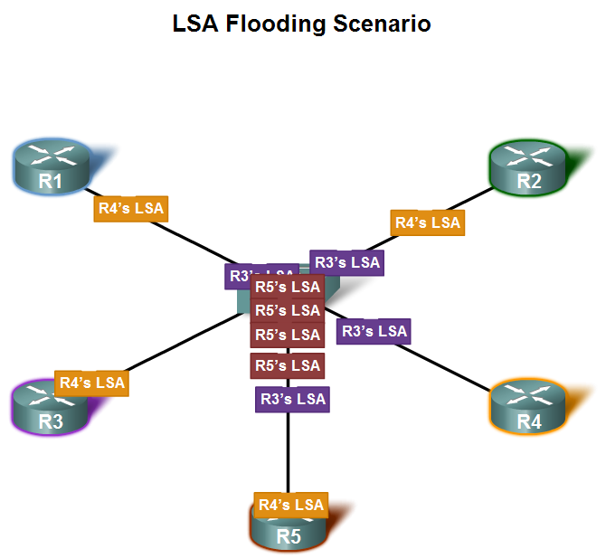
OSPF in Multiaccess Networks
Extensive flooding of LSAs
  For every LSA sent out there must be an acknowledgement of receipt sent back to transmitting router.
  consequence: lots of bandwidth consumed and chaotic traffic

Slide 45
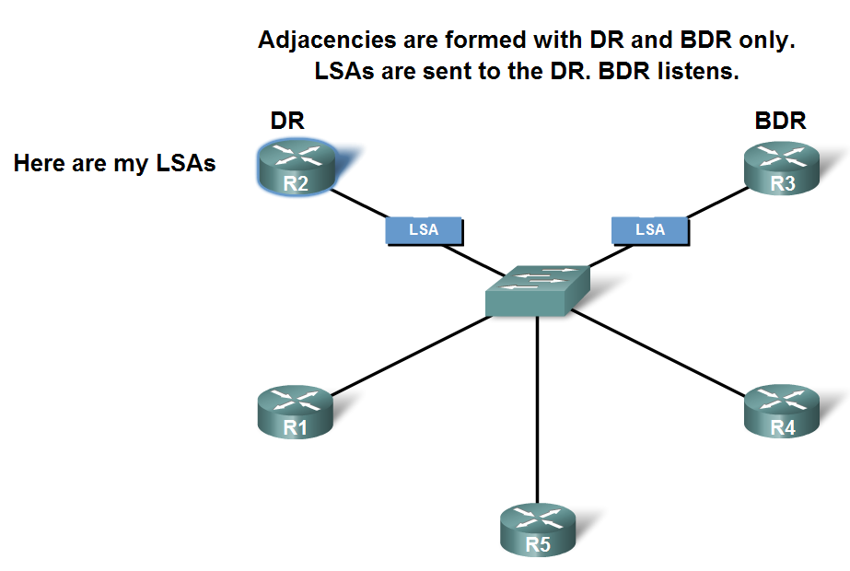
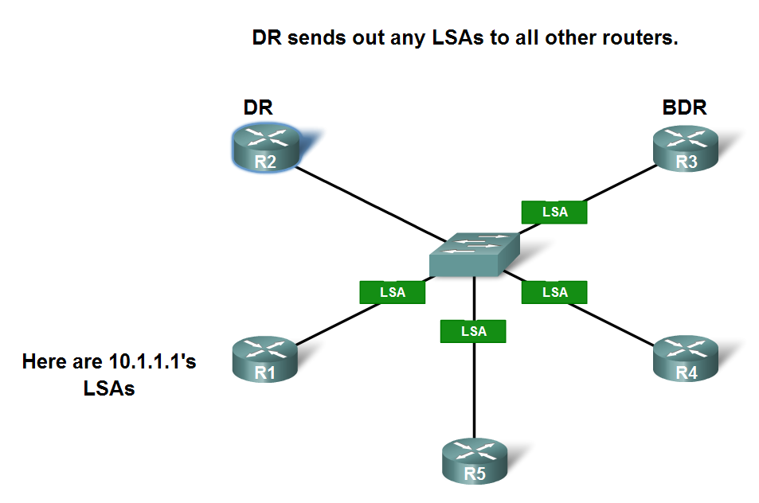
OSPF in Multiaccess Networks
Solution to LSA flooding issue is the use of
  Designated router (DR)
  Backup designated router (BDR)
DR & BDR selection
  Routers are elected to send & receive LSA
Sending & Receiving LSA
  DRothers send LSAs via multicast 224.0.0.6 to DR & BDR
  DR forward LSA via multicast address 224.0.0.5 to all other routers

Slide 46
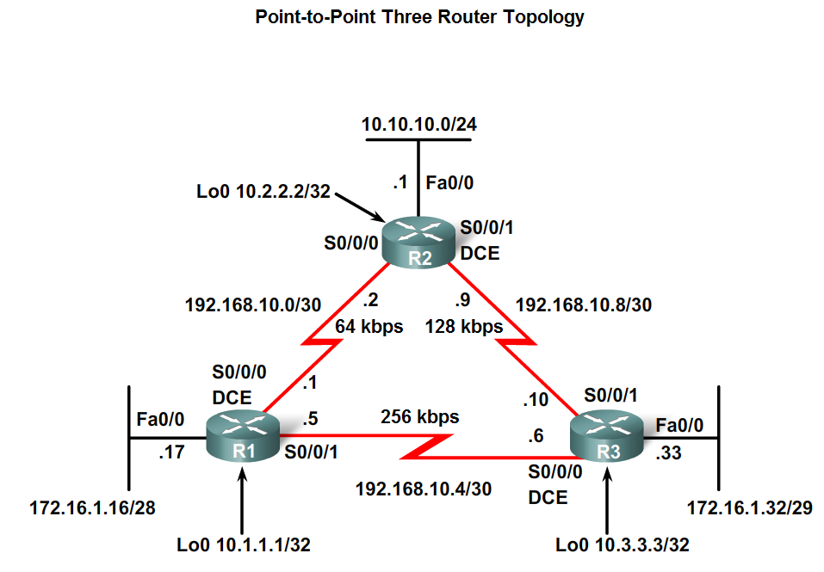
OSPF in Multiaccess Networks
DR/BDR Election Process
DR/BDR elections DO NOT occur in point to point networks

Slide 47
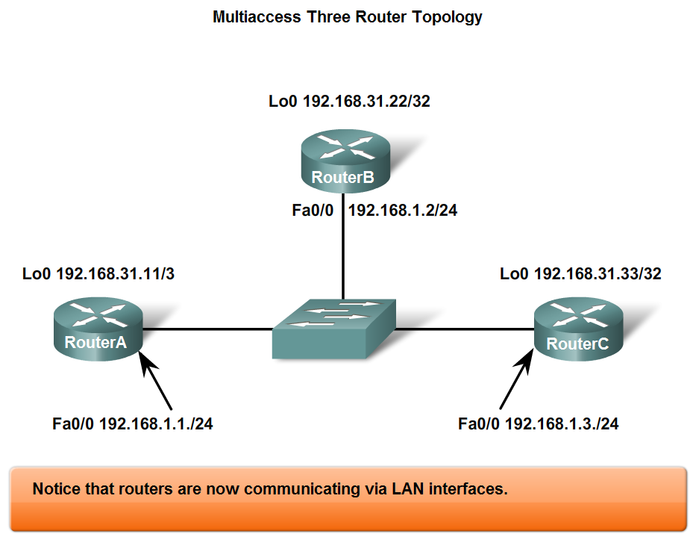
OSPF in Multiaccess Networks
DR/BDR elections will take place on multiaccess networks as shown below

Slide 48
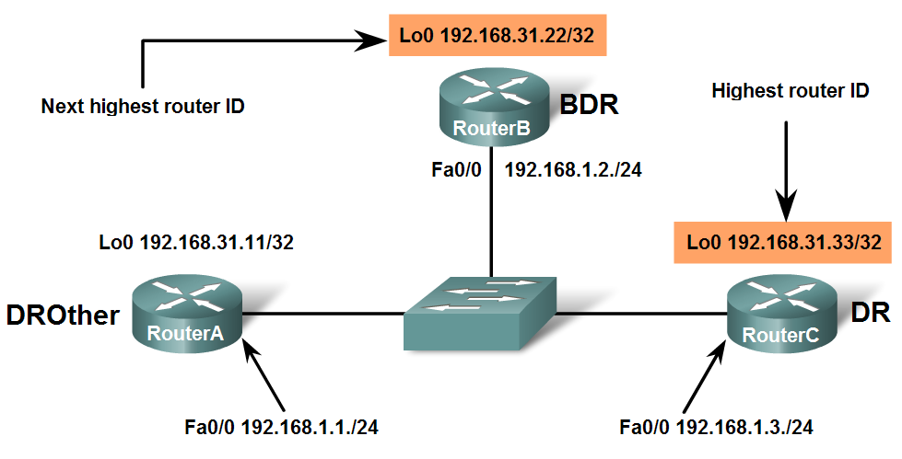
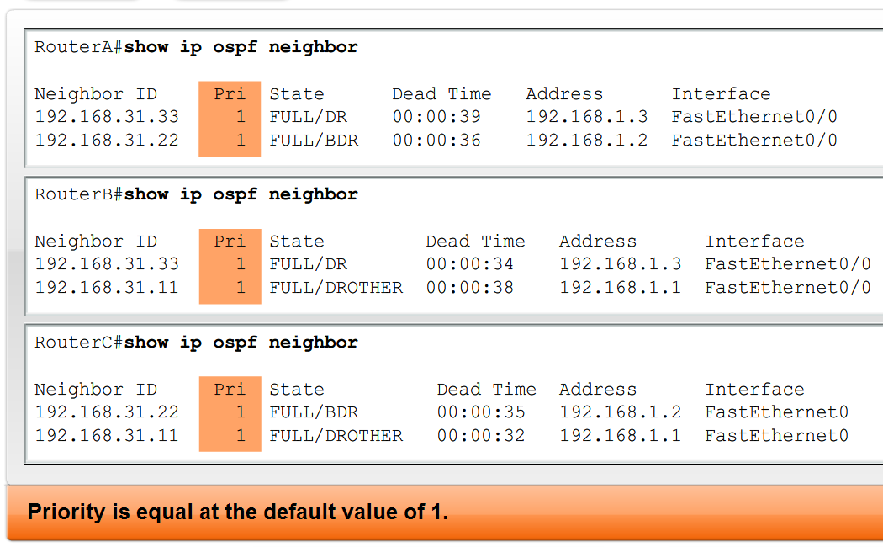
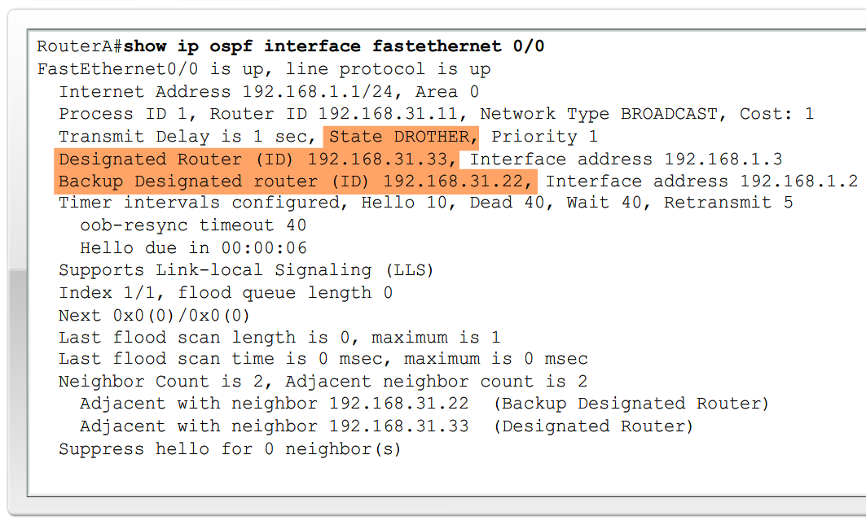
OSPF in Multiaccess Networks
Criteria for getting elected DR/BDR
  DR: Router with the highest OSPF interface priority.
  2. BDR: Router with the second highest OSPF interface priority.
  3. If OSPF interface priorities are equal, the
  highest router ID is used to break the tie.

Slide 49
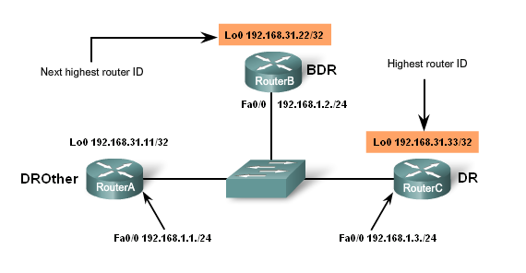
DR and BDR Selection

Slide 50
Selection Process
In this example, the default OSPF interface priority is 1.
As a result, based on the selection criteria listed above, the OSPF router ID is used to elect the DR and BDR. As you can see, RouterC becomes the DR and RouterB, with the second highest router ID, becomes the BDR. Because RouterA is not elected as either the DR or BDR, it becomes the DROther.
DROthers only form FULL adjacencies with the DR and BDR, but will still form a neighbor adjacency with any DROthers that join the network.
This means that all DROther routers in the multiaccess network still receive Hello packets from all other DROther routers.
In this way, they are aware of all routers in the network. When two DROther routers form a neighbor adjacency, the neighbor state is displayed as 2WAY. The different neighbor states are discussed in CCNP.

Slide 51
OSPF in Multiaccess Networks
Timing of DR/BDR Election
  Occurs as soon as 1st router has its interface enabled on multiaccess network
    When a DR is elected it remains as the DR until one of the following occurs
      -The DR fails.
      -The OSPF process on the DR fails.
      -The multiaccess interface on the DR fails.

Slide 52
OSPF in Multiaccess Networks
Manipulating the election process
  -If you want to influence the election of DR & BDR then do one of the following
    Boot up the DR first, followed by the BDR, and then boot all other routers,
    OR
    Shut down the interface on all routers, followed by a no shutdown on the DR, then the BDR, and then all other routers.

Slide 53
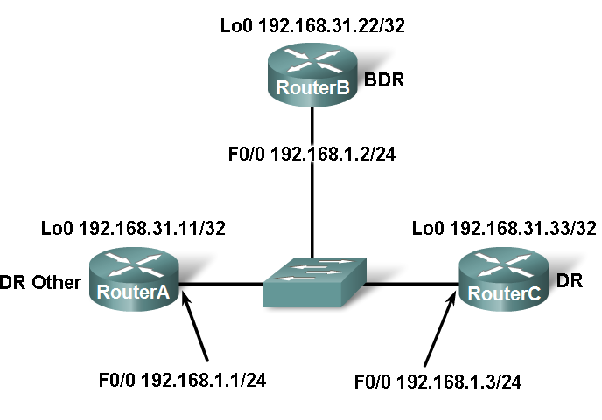
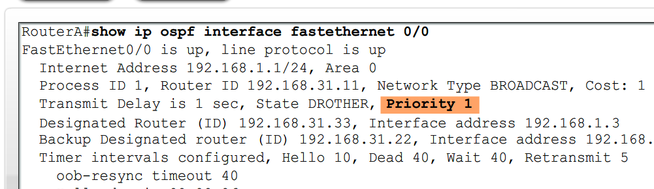
OSPF in Multiaccess Networks
OSPF Interface Priority
Manipulating the DR/BDR election process continued
  Use the ip ospf priority interface command.
  Example:Router(config-if)#ip ospf priority {0 - 255}
    Priority number range 0 to 255
      0 means the router cannot become the DR or BDR
      1 is the default priority value

Slide 54
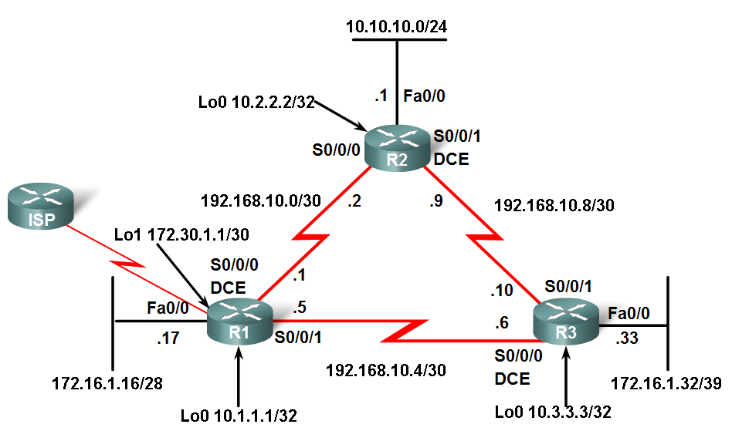
More OSPF Configuration
Redistributing an OSPF Default Route
Topology includes a link to ISP
  Router connected to ISP
    Called an autonomous system border router
    Used to propagate a default route
      Example of static default route
      R1(config)#ip route 0.0.0.0 0.0.0.0 loopback 1
      Requires the use of the default-information originate command
      Example of default-information originate command
      R1(config-router)#default-information originate

Slide 55
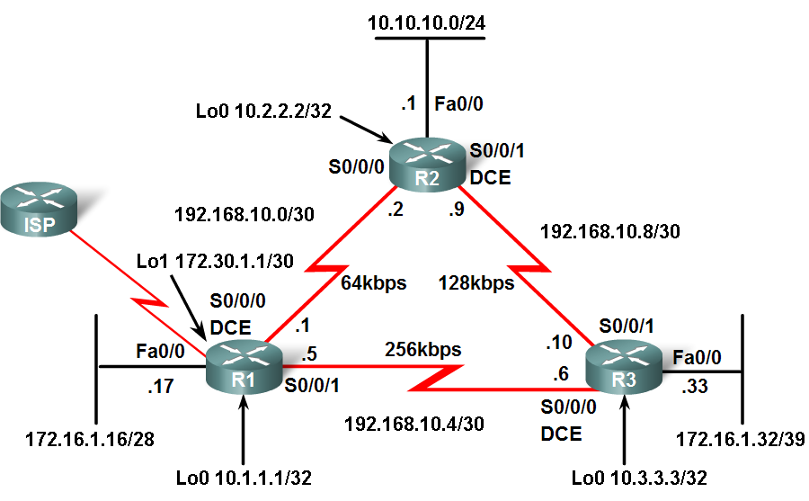
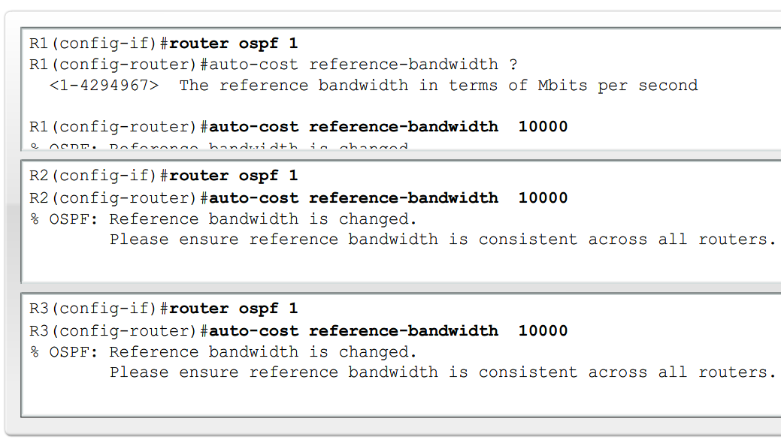
More OSPF Configuration
Fine-Tuning OSPF
Since link speeds are getting faster it may be necessary to change reference bandwidth values
  Do this using the auto-cost reference-bandwidth command
  Example:
  R1(config-router)#auto-cost reference-bandwidth 10000

Slide 56
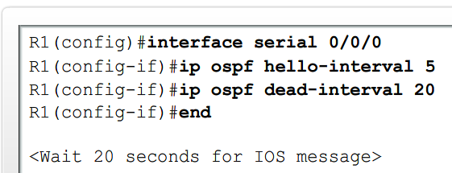
More OSPF Configuration
Fine-Tuning OSPF
Modifying OSPF timers
  Reason to modify timers
    Faster detection of network failures
  Manually modifying Hello & Dead intervals
    Router(config-if)#ip ospf hello-interval seconds
    Router(config-if)#ip ospf dead-interval seconds
  Point to be made
    Hello & Dead intervals must be the same between neighbors

Slide 57
Summary
RFC 2328 describes OSPF link state concepts and operations
OSPF Characteristics
  A commonly deployed link state routing protocol
  Employs DRs & BDRs on multi-access networks
    DRs & BDRs are elected
    DR & BDRs are used to transmit and receive LSAs
  Uses 5 packet types:
  1: HELLO
        2: DATABASE DESCRIPTION
        3: LINK STATE REQUEST
        4: LINK STATE UPDATE
        5: LINK STATE ACKNOWLEDGEMENT

Slide 58
Summary
OSPF Characteristics
  Metric = cost
    Lowest cost = best path
Configuration
  Enable OSPF on a router using the following command
    R1(config)#router ospf process-id
  use the network command to define which interfaces will participate in a given OSPF process
    Router(config-router)#network network-address wildcard-mask area area-id

Slide 59
Summary
Verifying OSPF configuration
  Use the following commands
    show ip protocol
    show ip route
    show ip ospf interface
    show ip ospf neighbor

